Slide 1
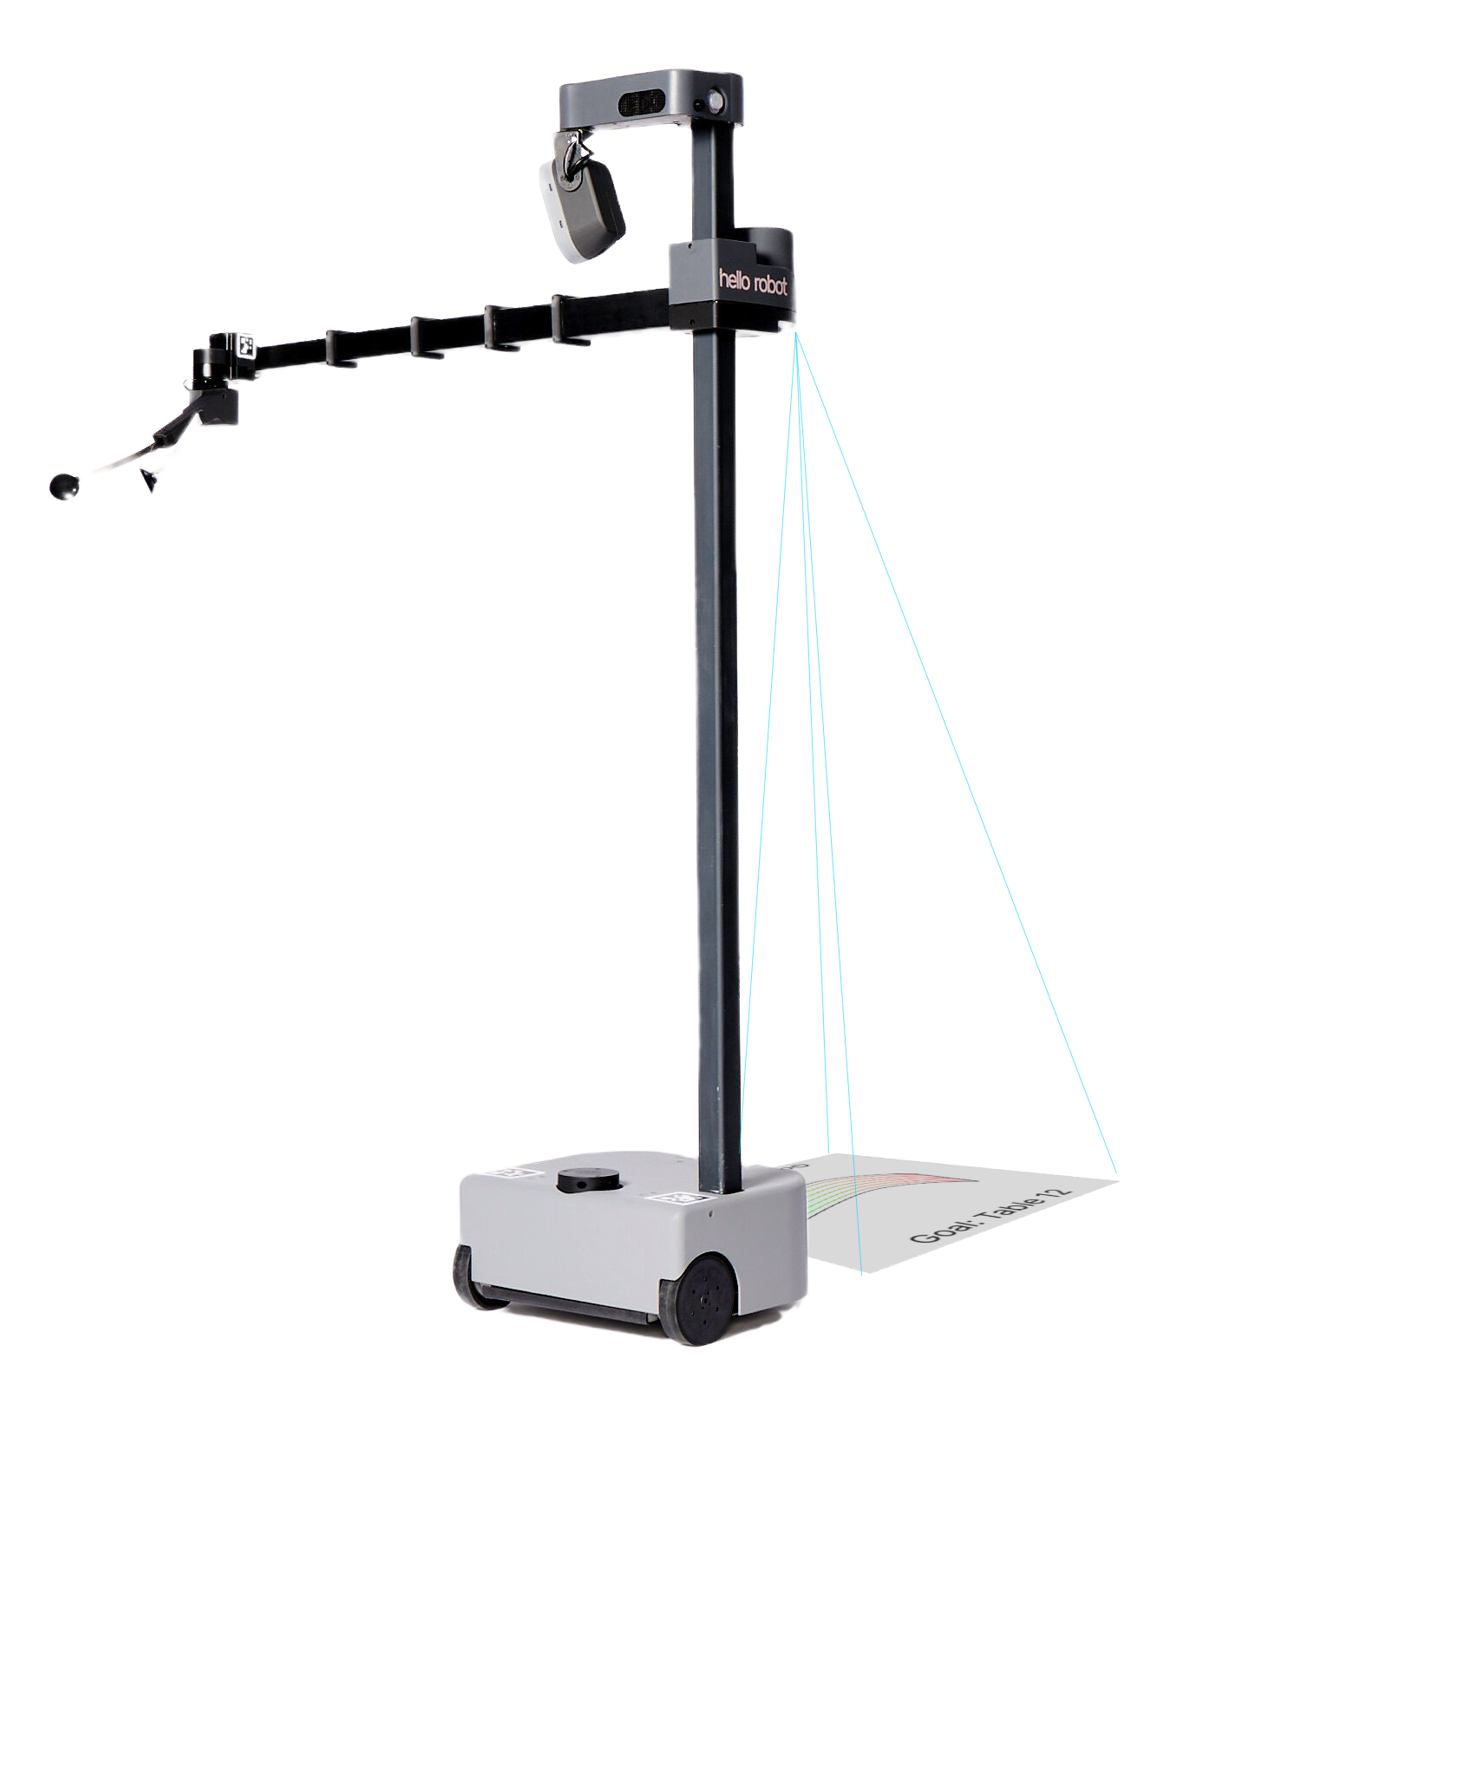
Projectable Robot Intent
Amogh Chinnakonda, Nigam Katta, Hemanth Surya
CS 7633 – Dr. Chernova
Notes:
Opening slide about you and introducing your project

Slide 2
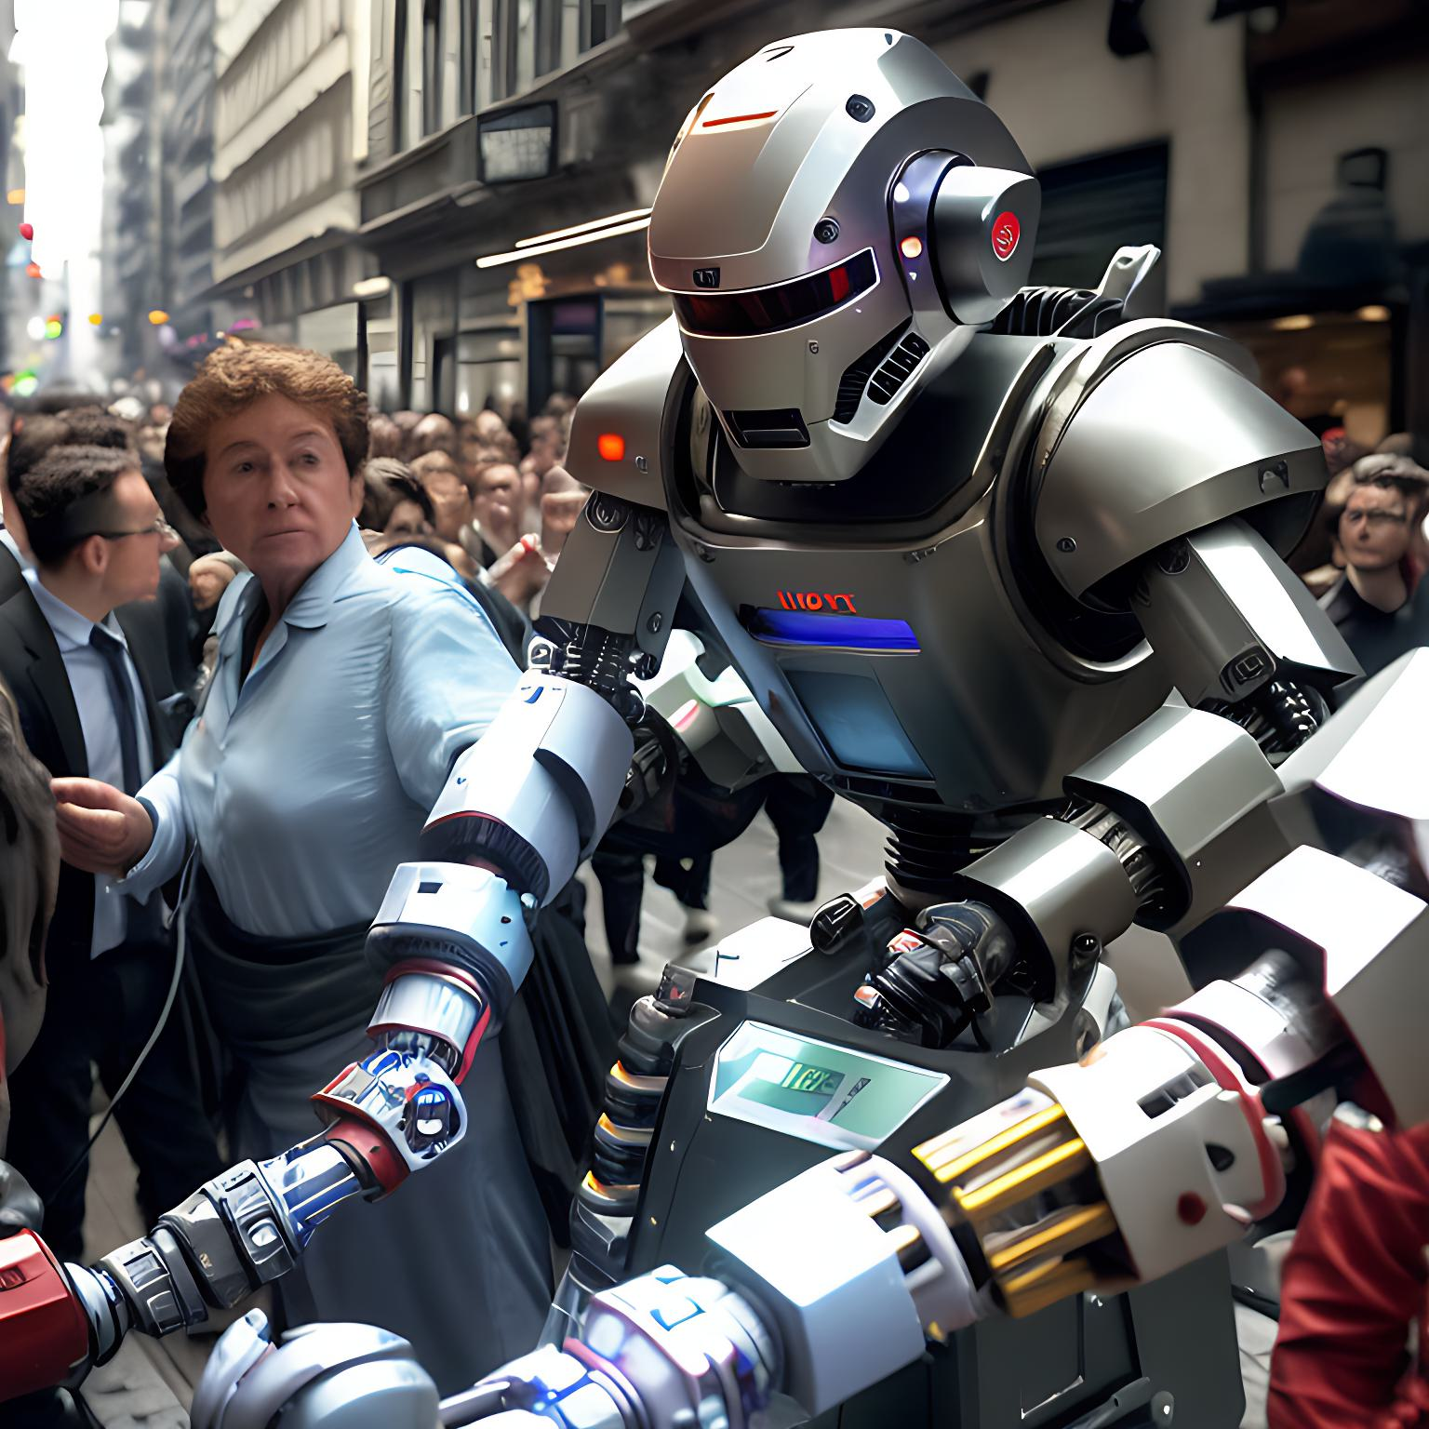
Motivation:
What are you up-to mister?
With the rise of robots in social environments, effective communication between humans and robots is more important than ever.
Difficulty in predicting a robot's future actions during social interactions.
Need for effective communication of robot's intentions and goals to people.
Sense of uncertainty and fear of collision when walking near robots in crowded scenarios.
des
Notes:
What is the value proposition?

Slide 3
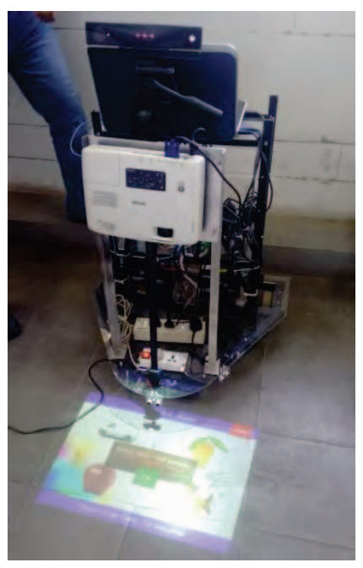
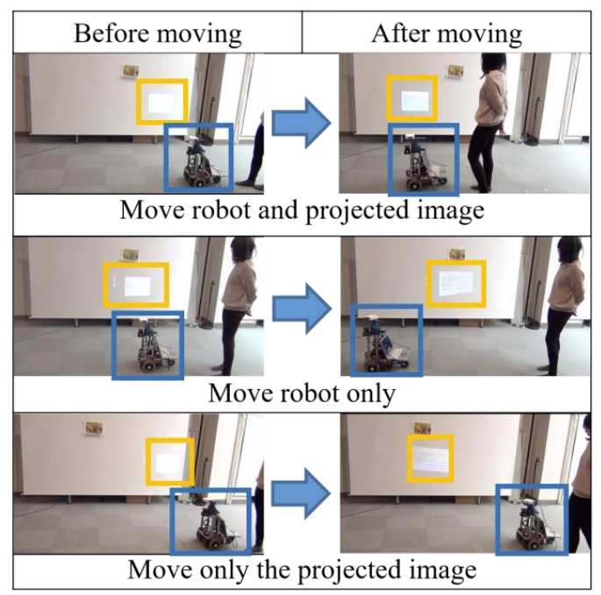
Related Works
[1] Agarwal, R., et al. “Touchless Human-Mobile Robot Interaction Using a Projectable Interactive Surface.”
2016 IEEE/SICE International Symposium on System Integration (SII), 2016,
The paper describes a mobile robot integrated with a Projectable Interactive Surface that can interact with humans of any physical attribute without recalibration. The system uses a projector and a Microsoft Kinect for gesture tracking and responding with an audio-visual signal without physical contact.
[2] Tamai, Aki, et al. “A Method for Guiding a Person Combining Robot Movement and Projection.” 2019 IEEE/RSJ International Conference on Intelligent Robots and Systems (IROS), 2019,
The paper proposes a new method for guiding people along a route when a mobile robot explains an exhibition. The method uses a mobile robot with a projection function to control human positions without explicit instructions by combining movement and projection of a robot. The paper introduces three basic guiding behaviors combining projection and movement that can guide a person effectively while controlling the position of the person.
Notes:
What is the value proposition?

Slide 4
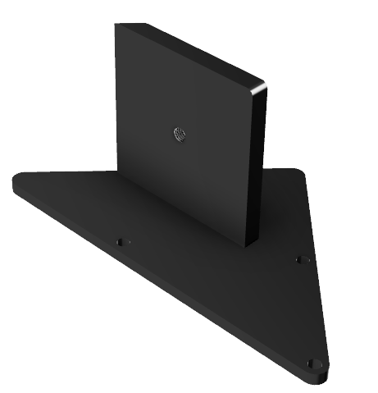
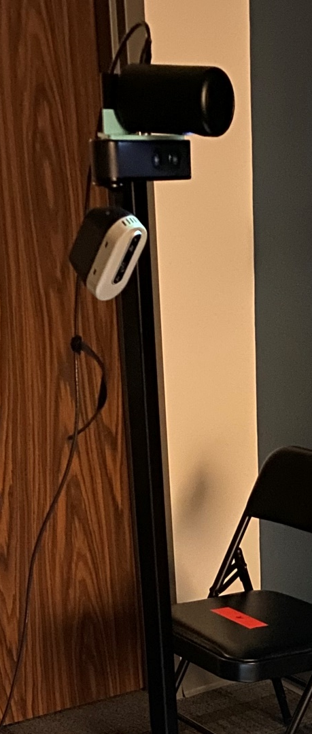
Hardware
Designed and prototyped custom, 3D printed projector mount with Fusion 360
Securely fastens projector to Hello Robot during operation
Allows for optimal projection for human viewing
Notes:
What is the problem?

Slide 5
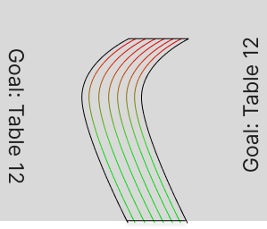

Software
Developed dynamic graphic of robot path trajectory and goal position
Safety warnings for nearby detected obstacles and people
Utilized ROS NavStack and Python GUI
Notes:
What is the problem?

Slide 6
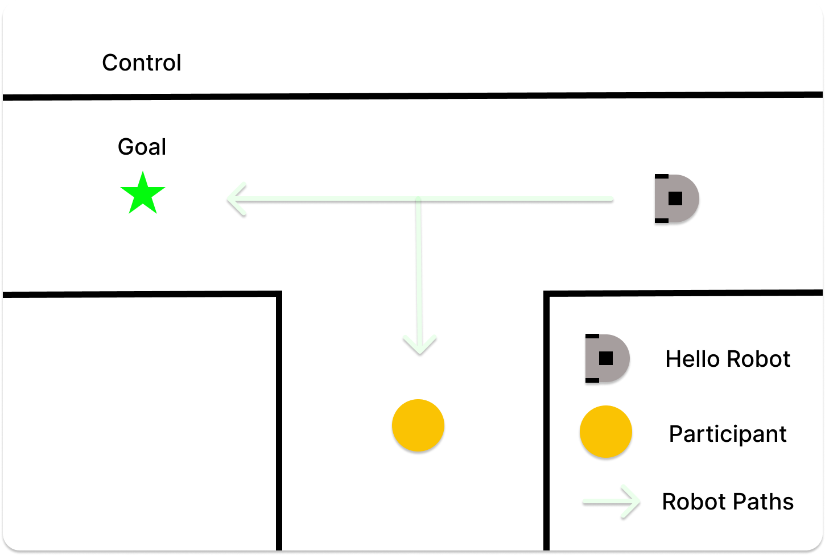
User Study
Control:
Participant is told to take a left and reach the goal position marker
Robot randomly either goes toward the goal position marker or participant’s starting position
Time taken to reach goal and subjective measures on participant behavior are recorded
Notes:
What is the problem?

Slide 7
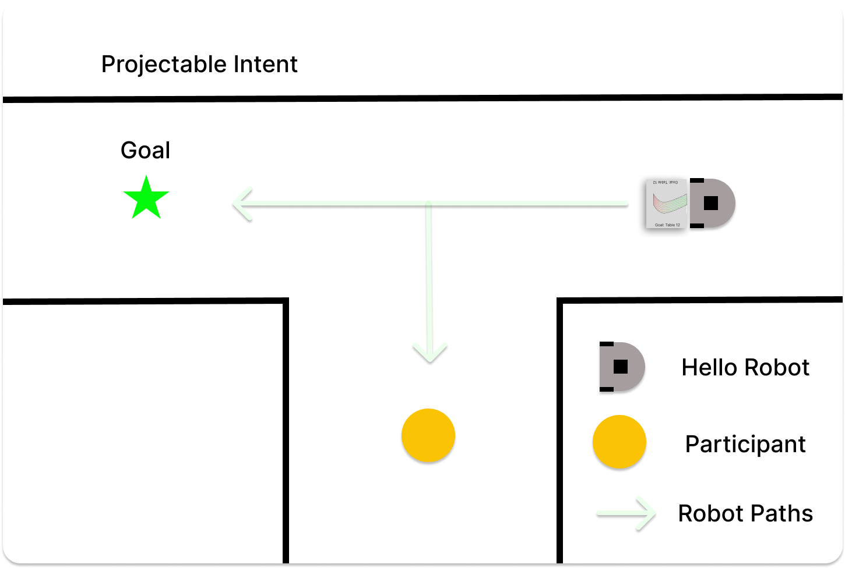
User Study
Projectable Intent:
Participant is told to take a left and reach the goal position marker
Robot randomly either goes toward the goal position marker or participant’s starting position and shows path trajectory on ground
Time taken to reach goal and subjective measures on participant behavior are recorded
Notes:
What is the problem?

Slide 8
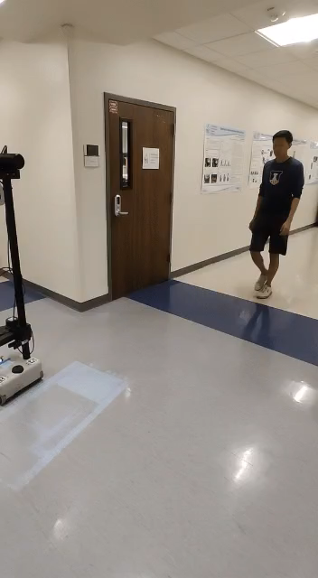
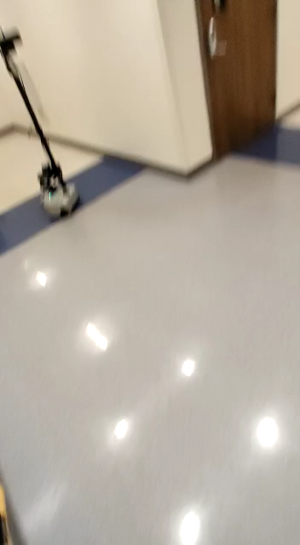
Notes:
What is the problem?

Slide 9
Hypotheses
H1 - Participants who interact with the robot with projectable intent are more likely to reach the destination in less time compared to those interacting with the robot without projectable intent.
H2 - Participants who interact with the robot with projectable intent feel significantly safer than those who interacted without with projectable intent .
Notes:
What is the problem?

Slide 10
H1 ✔︎
Results
Running a Two-Sample t-Test between subjects for time taken to reach the goal and for subjective safety measures
Time-to-Goal (s):
M_{control} = 15.84, M_{projector} = 11.01
SD_{control} = 26.05, SD_{projector} = 4.85
t (14) = 2.46, p = 0.027 < 0.05
Subjective Safety:
M_{control} = 5.62, M_{projector} = 8.12
SD_{control} = 2.27 , SD_{projector} = 1.84
t (14) = -3.21 , p = 0.015 < 0.05
H2 ✔︎
Notes:
What is the problem?

Slide 11
Participant Comments:
My Attention was drawn to the screen on the floor.
Adding a control study could be a good idea.
Cool looking robot!
more instructions??? i was confused
Twas fun.
Great Job!
Notes:
What is the problem?

Slide 12
Future Works
GUI can be updated to show additional information relevant to the application such as advertisements, etc.
The study can be conducted by formulating more hypotheses and involving more participants to get accurate results.
Implement multiple interactions of the user with the robot to get more inferences.
Use the projectors that can have more visual capabilities in different light conditions.
Implement a better navigation stack that gives accurate trajectory
Notes:
What is the problem?

Slide 13
Thank You!

